Slide 1

Transactions Monitoring
.

Slide 2
Findings About Data
Duplicate Rows- The data has 945 duplicate rows to which I have not removed as there can be possibility of sending same amount to same country by same customer.
On analyzing , I got 94 customers who did repeated transactions once or twice but customer with id 5860 did 849 times repeated transactions.
Negative Values:- The data has 102 negative values as amount cant be negative, I removed these rows as I found these data points to be inconsistent.
Country Data :- The data for counterpart_country is not normalized as data points for three countries ,namely, CY,RU,PL, are only 2, 1,1 respectively.
So ,on further analyzing the these 4 rows I got the value of amount to be superficial .
And the data points are too less to provide insights of these countries. So, I removed these data points.

Slide 3

Why Romania is suspicious Country?
On analyzing the data points for Romania (RO), minimum amount of money transacted is higher than other countries and maximum amount of money transacted is also higher than other countries.
As per the government rule, the transactions above 100,000 Euros is only possible under government jurisdiction .
Threshold For Each and Every Segment:-
Cluster0-4039
Cluster1-6047
Cluster2-5097
Cluster3-6013
Cluster4-4013

Slide 4
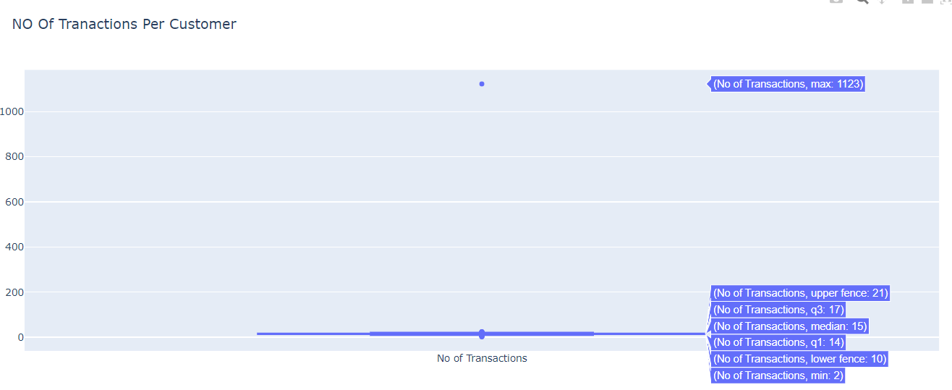
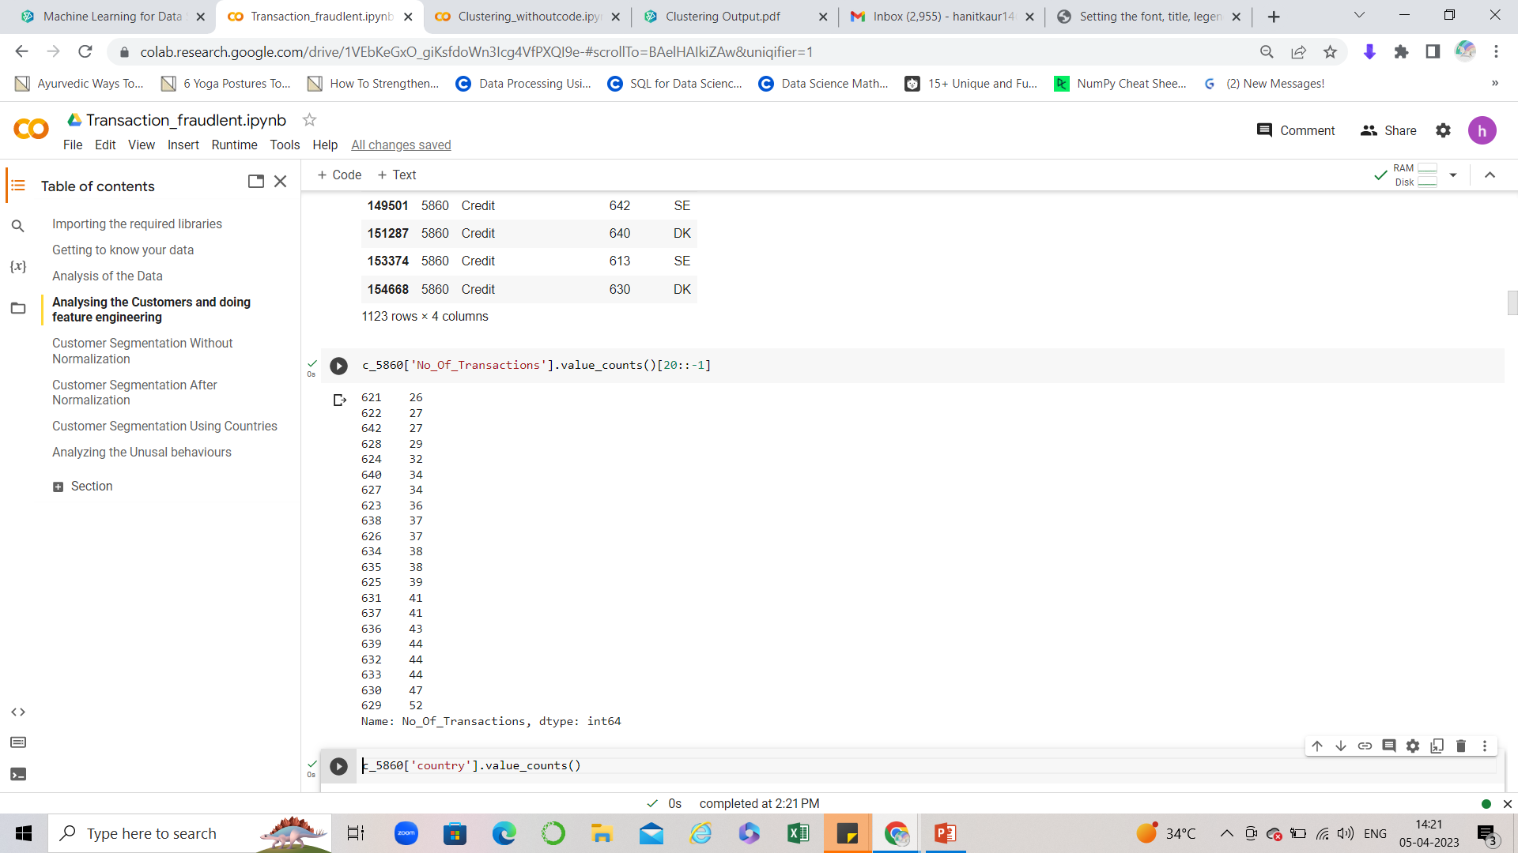
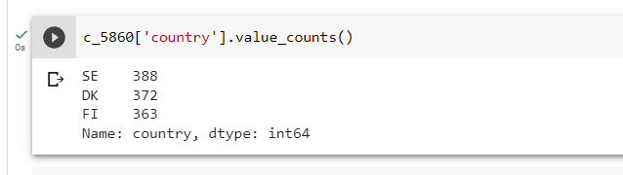
Suspicious Customers
On analyzing the customer details, it was found that customer_id 5860, has done maximum amount of transactions which accounts to 1123 transactions over a period of one month.
And this is the only potential outlier and Q2 is 15.
On analyzing further, this customer has done transactions of approximately 600 Euros to SE, FI, DK 388, 372, 363 times
Out of 1123 only 18 transactions are of higher denominations of approximately 6000 Euros.
So, customer_id 5860 , is suspicious customer .

Slide 5
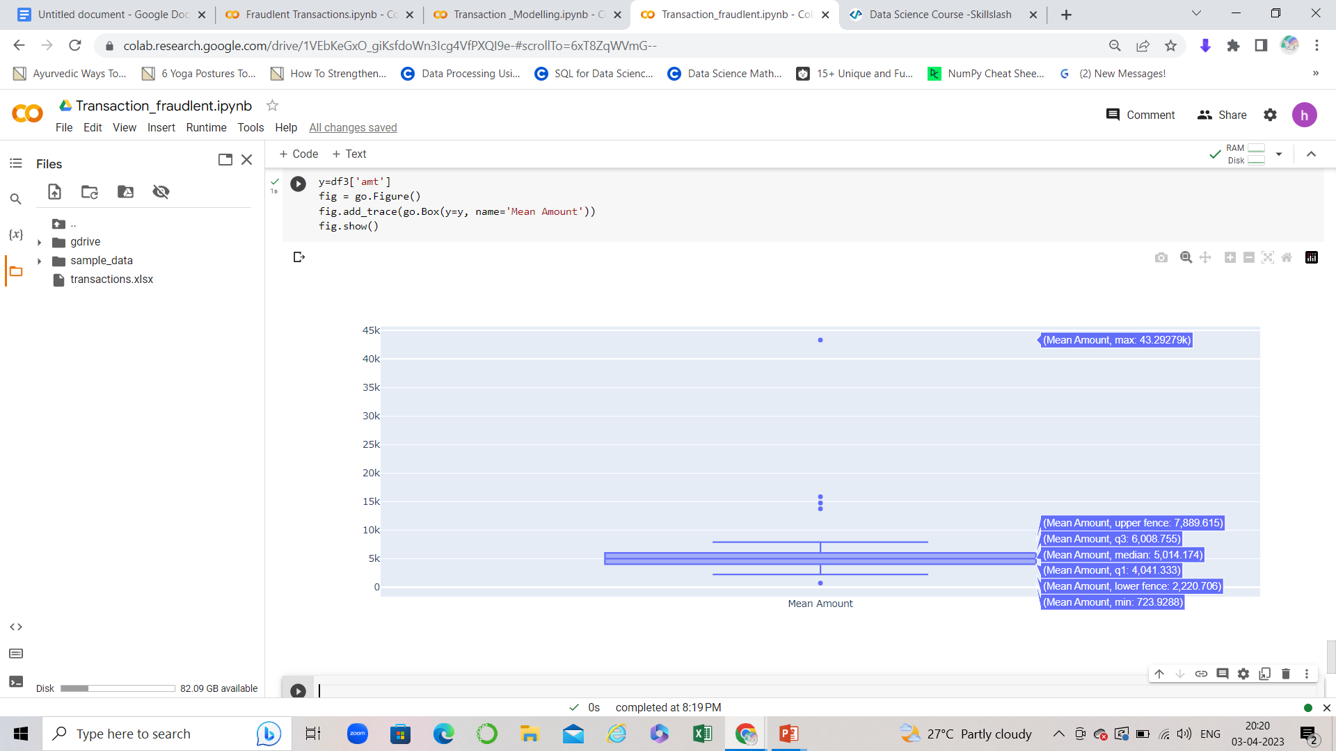
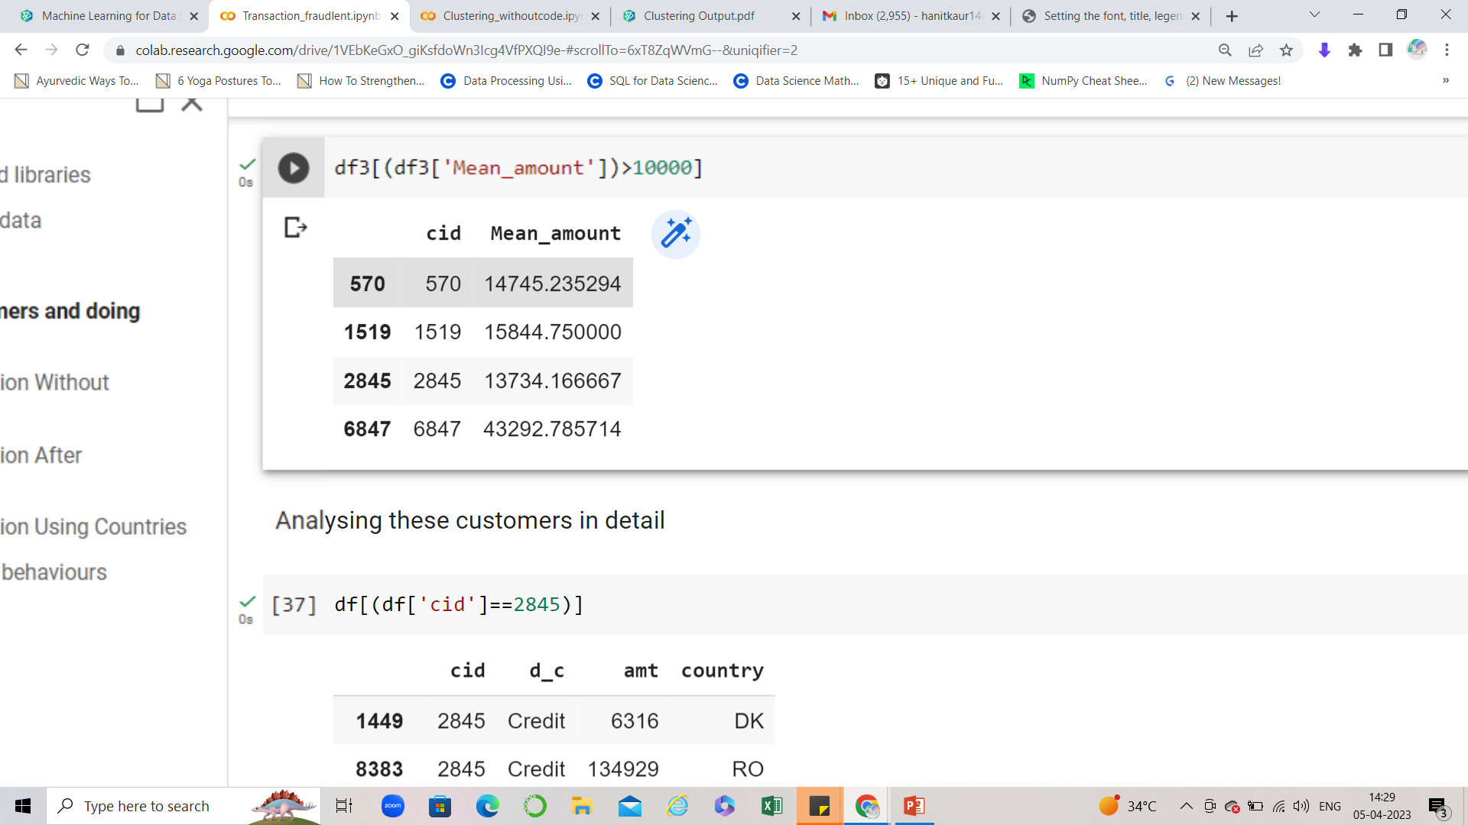
Questionable Customer_ids
On analysing the customers on the basis of their average transactions done on the basis of amount. There were only four customer_id that were the potential outliers and which had mean amount exceeding the 10000 Euros.
Mean Amount is 5000 Euros.
C_id 6847 has maximum of the time transacted above mean amount and once transacted amount more than 500,000 EUROS which is exceeding the limit.
C_id 2845 also has the same pattern as C_id 6847 .
Since these customer id’s may come under the suspicious categories but if provided more data points like 2 or 3 months previous history of the transactions that more insights could be given.
For customer segmentation, I have removed the three customer_ids 6847, 2845 and 5860 as clustering is prone to outliers.

Slide 6
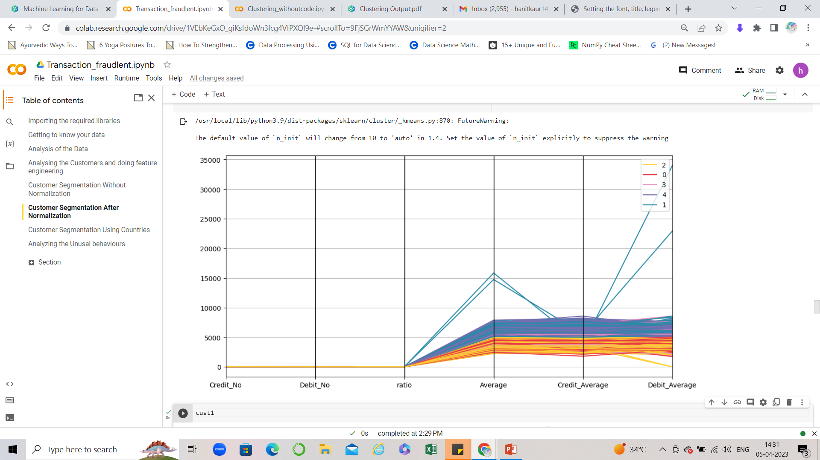
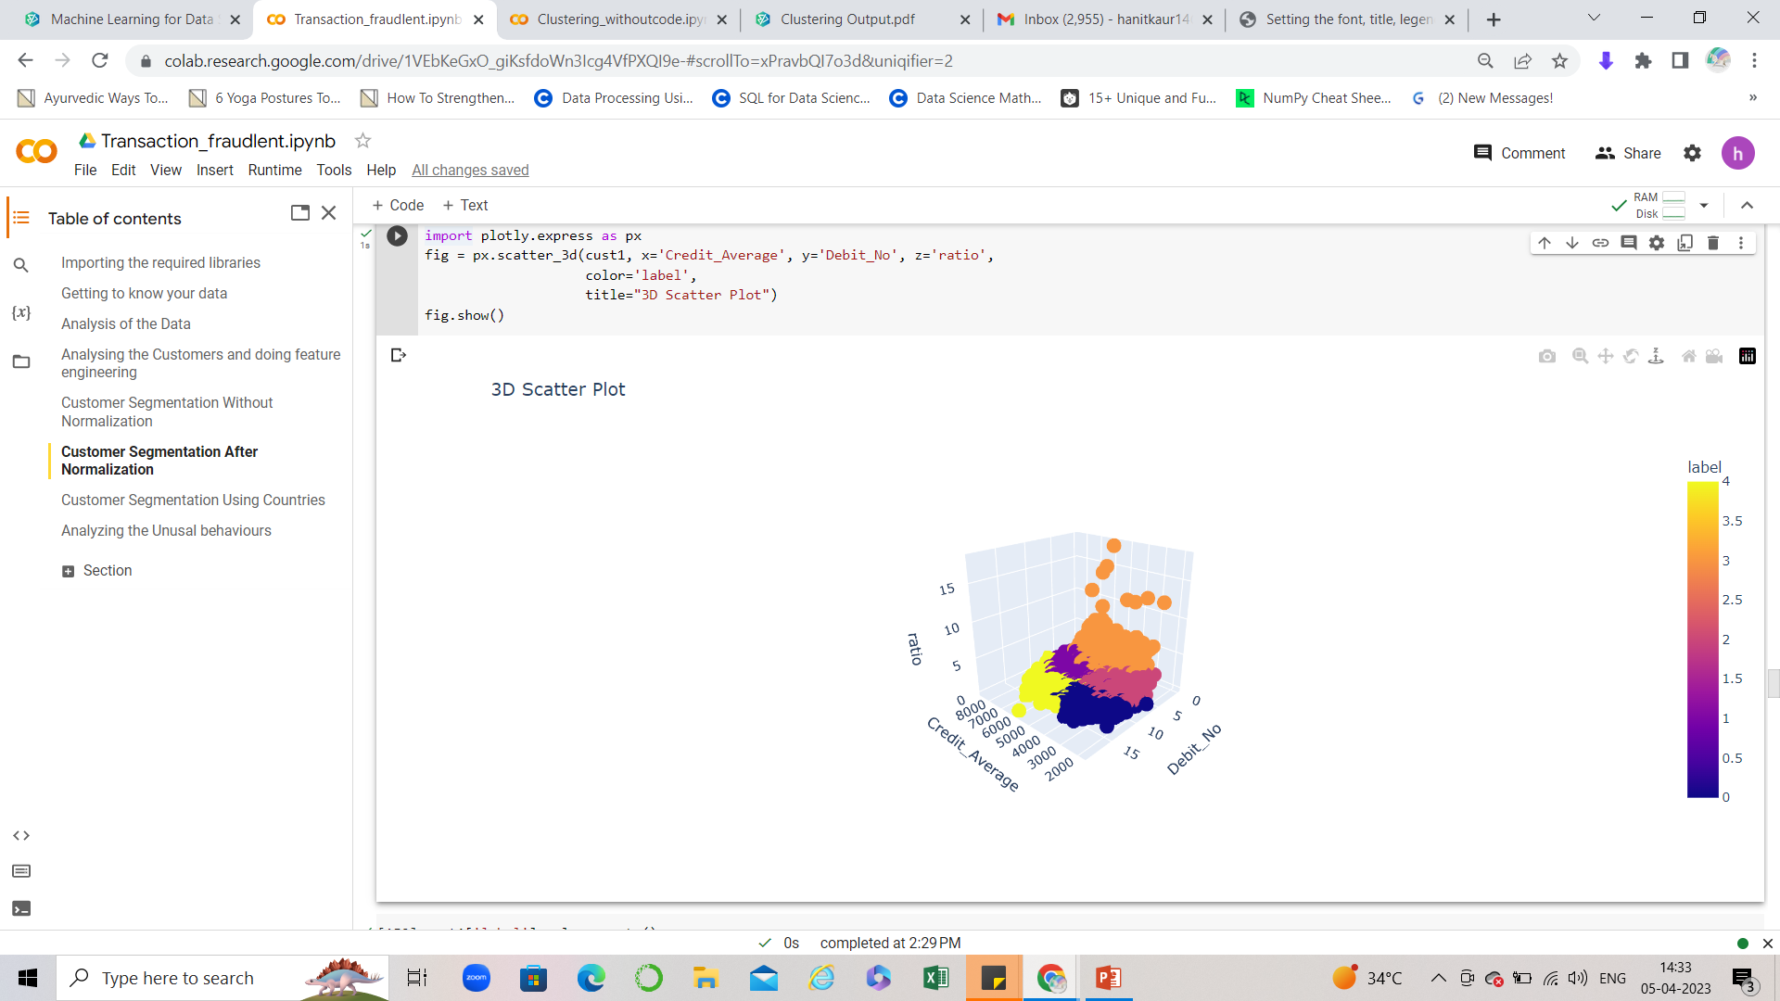
Segmentation Of Customers
On segmenting the customers on the basis of following features:-
No of Credit transactions
No of Debit transactions
Average
Credit/Debit Ratio
Average of Credit Transactions
Average of Debit Transactions
There are three clusters formed on the basis of Average, debit_average, and credit_average .
POTENTIAL OUTLIERS:-
Cluster 0- cid(7227,7510,9346,9107,8049)
Cluster 1- cid(9779,286,9911,9980,9905)
Cluster 2-cid(9796,195,9812,9928,9912)
Cluster 3-cid(9992,9990,9875,9940,71)
Cluster 4-cid(2985,2026,2128,5034,7157)

Slide 7
Thank You

